Slide 1

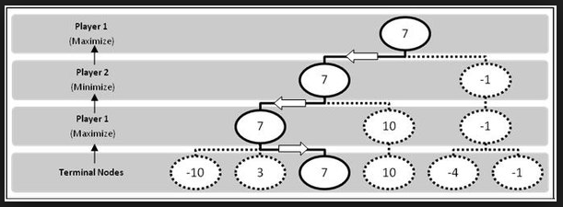

Slide 2

Adversarial Search
  Introduction
  Game Playing
  Min-Max Search
  Alpha Beta Pruning

Slide 3
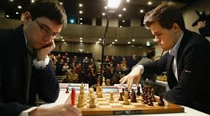
Adversarial Search problems (Game Playing)
  Multi-Agent env – Need to consider action of other agents
  Competitive env – The agent’s goals are in conflict (adversarial)
Ex: Chess or Tic-Tac-Toe
  Deterministic, turn-taking, two-player, zero-sum games
  Zero sum game - Total payoff to all players is same (0+1, 1+0, ½ + ½)
  One agents action has equal & opposite effect on other (One wins, other loses)

Slide 4
Games vs. Search problems
More than one agent
Harder to solve (search tree of chess has 35 nodes)
Deal with "Unpredictable" opponent
Time limits → If can not find the exact goal within time, must approximate
Ex: Chess & Tic-Tac-Toe
100

Slide 5
Formally defining a game
  S0 : Initial State – Game setup at the start
  PLAYER (s)– Which player has the move in a state
  ACTION (a)– Returns the set of legal moves
  RESULT (s,a)– Defines result of a move
  TERMINAL_TEST (s) – True if game is over & false otherwise
  UTILITY (s,p) – (objective / payoff function) – Final numeric value of a game that ends in terminal state ‘s’ for player ‘p’
    Ex: In Chess, the outcomes are win(1), loss(0) or draw(1/2)

Slide 6
GAME TREE
  Tree with nodes as game states & edges are moves
  Combination of Initial state, ACTION & RESULT functions
  See diagram on next page

Slide 7

MAX places ‘X’ & MIN places ‘O’ alternatively
Terminal state – One player has 3 ‘X’ or 3 ‘O’ in a row
Tic-Tac-Toe has < 9! (362880) terminal nodes
MAX has 9 possible moves
MIN has 8 possible moves

Slide 8
Optimal Decisions in games
  MAX & MIN are playing, MAX responds to all possible moves from MIN
  Optimal Strategy – Respond to “best possible move” of opponent
  Idea: choose the move with highest minimax value (given by utility/ payoff function)
  Ex: 2-Ply Game Tree (See diagram on next page)
Notes:
* Player “Max” chooses the action that results in Maximum Utility……. Player “Min” chooses the action that results in Minimum Utility

Slide 9

Three possible moves by MAX (at root) – A1, A2, A3
This one-move game ends after ½ moves (called Ply) each by MAX & MIN
Optimal move is determined by Utility of each node (A1 – 3, A2 – 2, A3 – 2) – MAX chooses maximum value & MIN chooses minimum value
Possible replies by MIN to A1 – A11, A12, A13 and so on..

Slide 10
Computes the minimax decision from the current state
Uses Recursive Computation of minimax values of each successor state
Recursion proceeds down the leaves of the tree & minimax values are backed up
Performs a complete DFS of the game tree
  Time Complexity – O (b )
  Space Complexly – O (bm) or O(m) (all actions generated at once or one at a time)
  Note: m – max depth of the tree, b – no. of legal moves at each point
m

Slide 11

// Action – a, State – s, v - utility
// v = max utility value of the state
// Returns action corresponding to the best utility value
// if terminal node return it’s utility
// v initialized to -infinity
// Visit successor level (apply action on states) & find the max utility value (v) & return it
// if terminal node return it’s utility
// v initialized to -infinity
// Visit successor level (apply action on states) & find the min utility value (v) & return it

Slide 12
Complete? Yes (if tree is finite)
Optimal? Yes (against an optimal opponent)

Slide 13
Problem with minimax – no. of game states to be explored is exponential in the depth of the game tree
This exponent can be cut down (in half) by pruning to eliminate large parts of the tree (called Alpha-Beta Pruning)
Consider the same 2-ply game

Slide 14
We can identify the minimax decision without evaluating 2 leaf nodes
Simplified minimax formula is given below
Consider the 2 unevaluated successors of node ‘A2’ have values ‘x’ & ‘y’
The value of the root node is given below (root value does not depend on pruned nodes x & y)
MINIMAX (root) = max ( min (3, 12, 8), min (2, x, y), min (14, 5, 2) )
= max ( 3, min (2, x, y), 2)
  = max ( 3, z, 2) where z = min (2, x, y) <= 2
  = 3
Z = min (2,x,y)
<= 2
No need to evaluate. Can be pruned

Slide 15
In Alpha-Beta Pruning, Often it is possible to prune entire sub tree than just leaves
Alpha – the value of the best (highest value) choice we have found so far along the path for MAX
Beta – the value of the best (lowest value) choice we have found so far along the path for MIN
Alpha-Beta search updates values of alpha & beta as it goes along
It prunes the remaining branches at a node
  When value of current node is worse than alpha (for MAX) & beta (for MIN)

Slide 16


Slide 17

No need to evaluate. Can be pruned

Slide 18

Need to evaluate. Can not be pruned

Slide 19


Slide 20


Slide 21
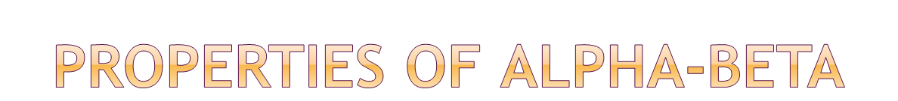
Pruning does not affect final result
Good move ordering improves effectiveness of pruning
With "perfect ordering" time complexity = O(b^{m/2})

Slide 22


Slide 23


Slide 24
Max
Min
5
5
4
4
3
3
7
8
9

Slide 25
Max
Min
Max
Min
7
5
10
9
2
6
9
6
4
2
11
13
3
1
12
10

Slide 26

Max
Min
Max
2
4
6
8
1
2
10
12

Slide 27


